Slide 1
ANALYZING AND VIZ. OF EPIDEMIC DISEASES MAINLY CORONAVIRUS (COVID)
Submitted by:
Shaik mohammed obaid

Slide 2
What is coronavirus ?
Coronaviruses are a group of viruses that cause disease in mammals and birds
In human coronaviruses cause respiratory tract infections that are typically mild, such as common cold .
Coronaviruses are transmitted between animals and humans.

Slide 3
OUTBREAK OF CORONAVIRUS
The novel coronaviruses (nCOV) is said to have originated from a seafood market in China’s Wuhan where wildlife was reportedly sold illegally.
It is not known yet which animals are responsible though many reports suggests it to be snakes.

Slide 4
Objective
To Analyse the number of people affected with Coronavirus through Confirmed, Recovered or Deaths.
To Visualize data for the same.

Slide 5
Libraries used
Pandas
Numpy
Matplotlib
Seaborn
Folium
Sklearn(LinearRegression)

Slide 6
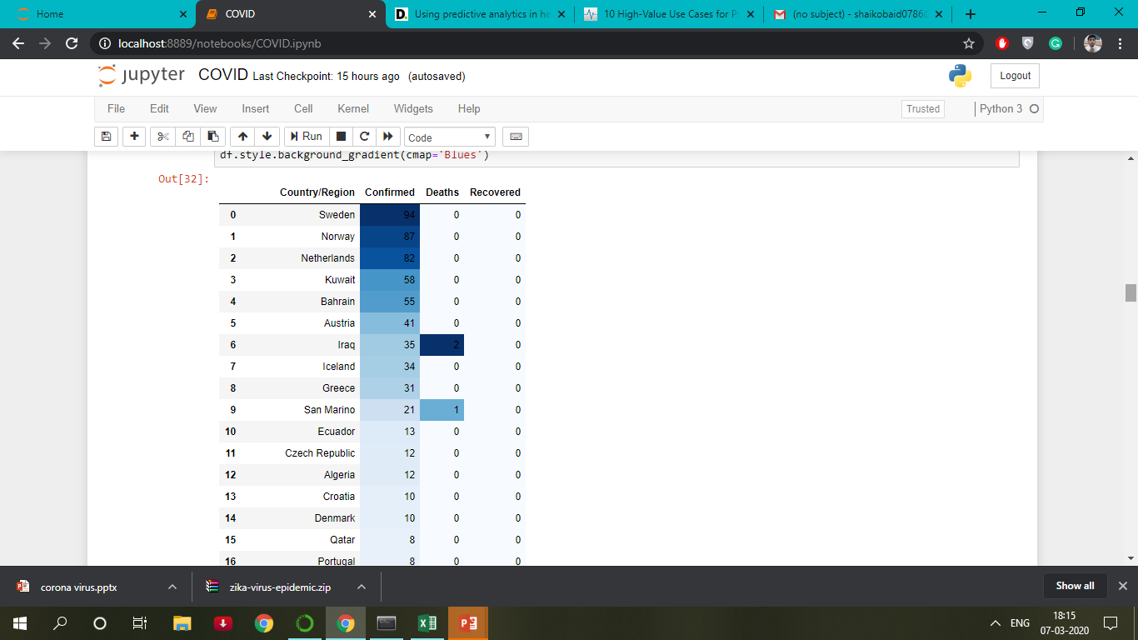
ANALYSIS

Slide 7
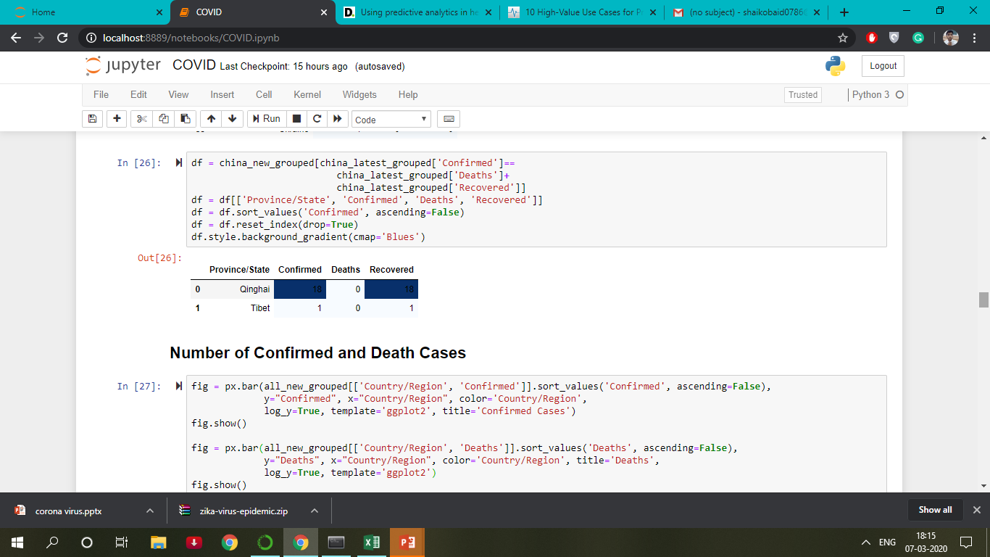

Slide 8
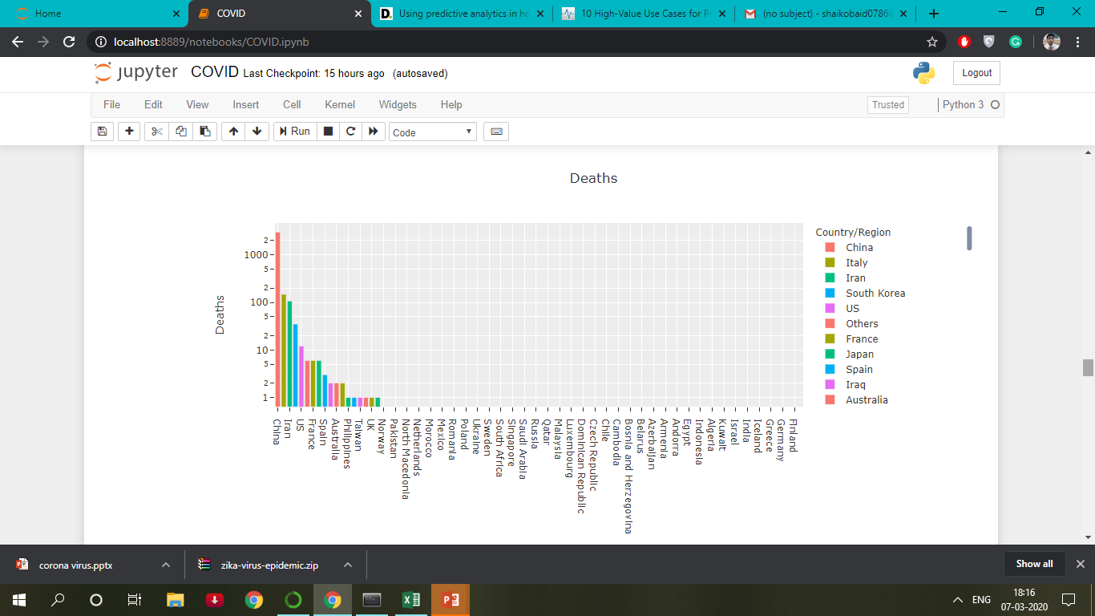
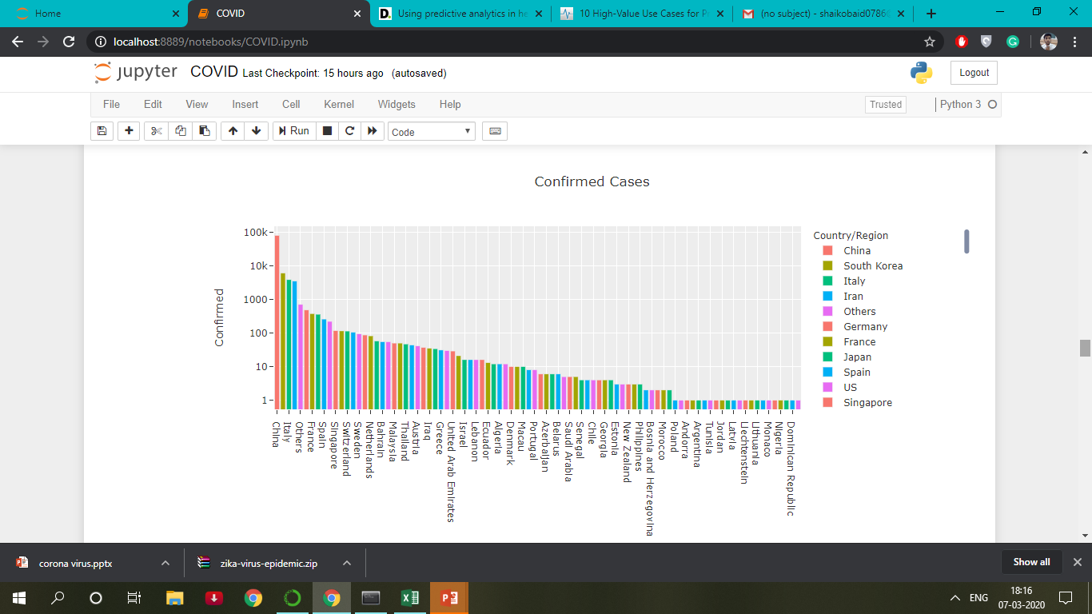
VISUALIZATION

Slide 9
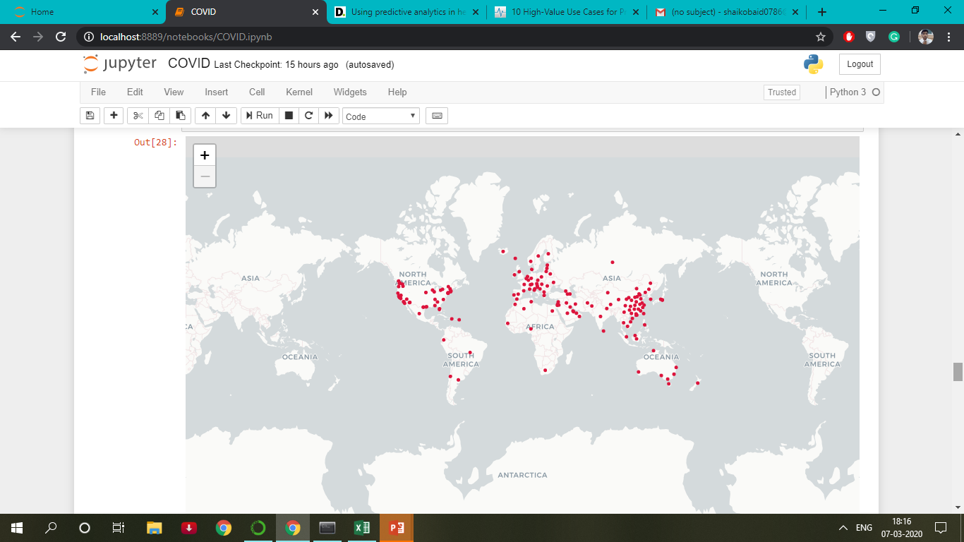
Across the globe

Slide 10
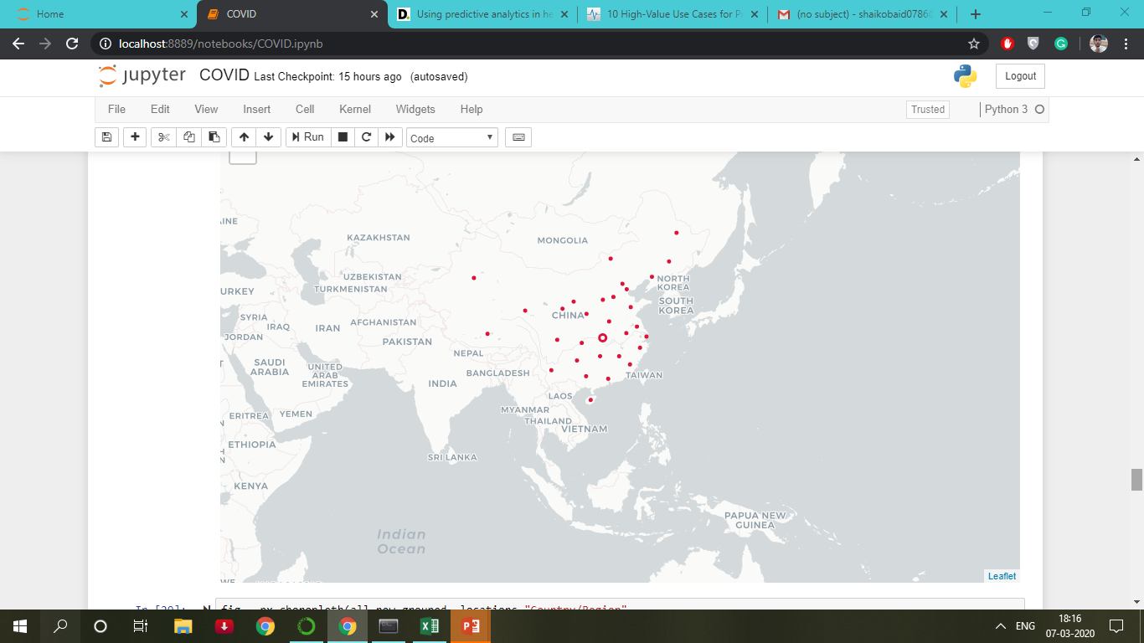
Across china

Slide 11
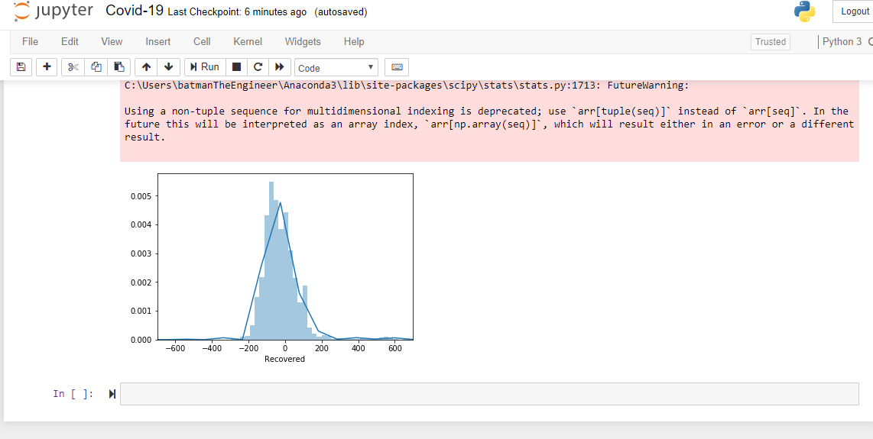
Prediction of Recovered cASES

Slide 12
BUSINESS ASPECTS
Data can be served to many of the medical companies to analyse and develop medicines to treat the coronavirus, hence the prototype.
Developing Precision Medicine And New Therapies
Improving efficiencies for operational management of health care business operations.
Accuracy of diagnosis and treatment in personal medicine.
Increased insights to enhance cohort treatment.

